Slide 1
Module 10
Classification

Slide 2
Prediction

Slide 3
Guessing the Value of an Attribute
Based on incomplete information
One way of making predictions:
To predict an outcome for an individual,
find others who are like that individual
and whose outcomes you know.
Use those outcomes as the basis of your prediction.
Two Types of Prediction
Classification = Categorical; Regression = Numerical

Slide 4
Prediction Example: Spam or Not?

Slide 5
Machine Learning Algorithm
A mathematical model
calculated based on sample data ("training data")
that makes predictions or decisions without being explicitly programmed to perform the task

Slide 6
Classification

Slide 7

Classification Examples

Slide 8
Classification Examples

Slide 9
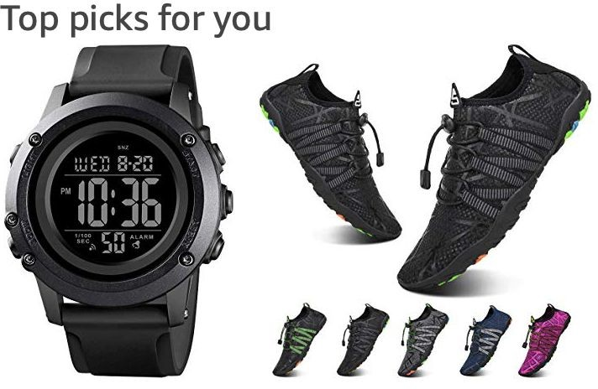

Classification Examples
(Demo)

Slide 10
Classifiers

Slide 11
Training a Classifier
Classifier
Attributes of an example
Predicted label of the example
Model the association between
Population
attributes & labels
Labels
Training
Set
Sample
Estimate the accuracy of the classifier
Test
Set

Slide 12
Nearest Neighbor Classifier
NN Classifier Use the label of the most similar training example
Attributes of an example
Predicted label of the example
Population
Training
Set
Attributes
Labels
Test
Set
(Demo)

Slide 13
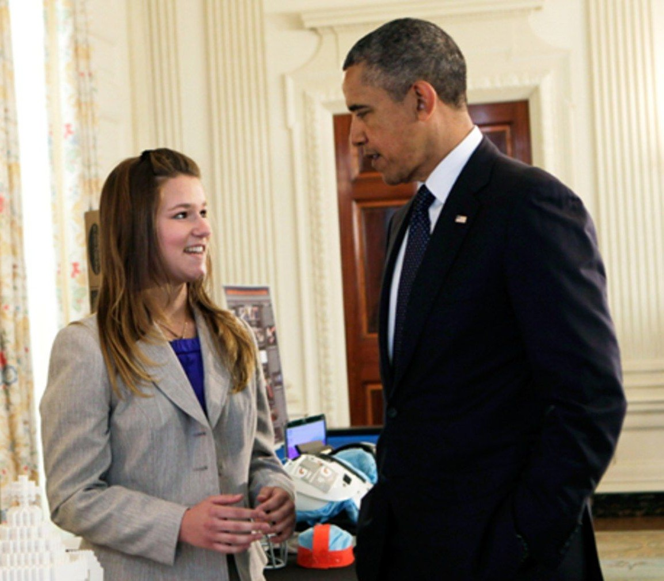
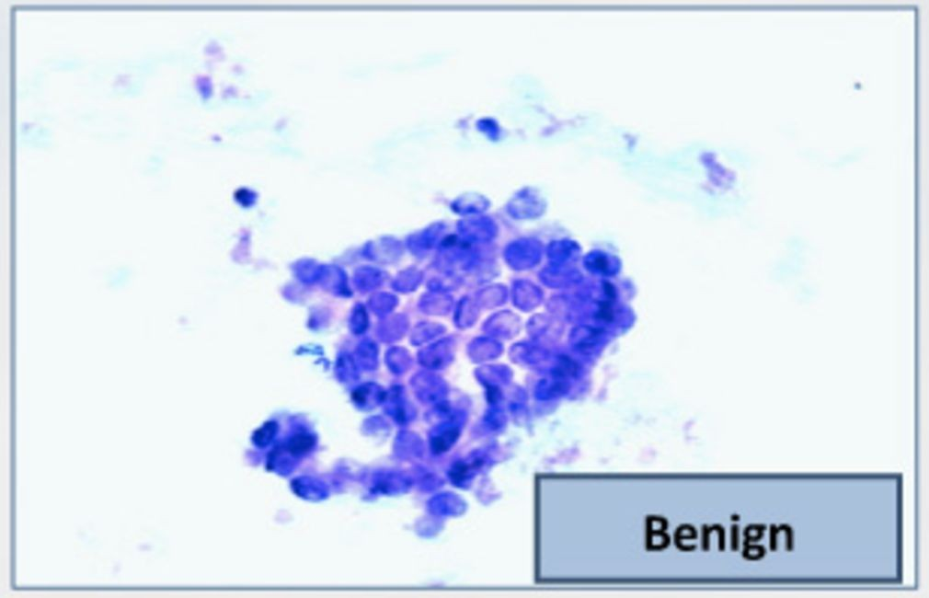
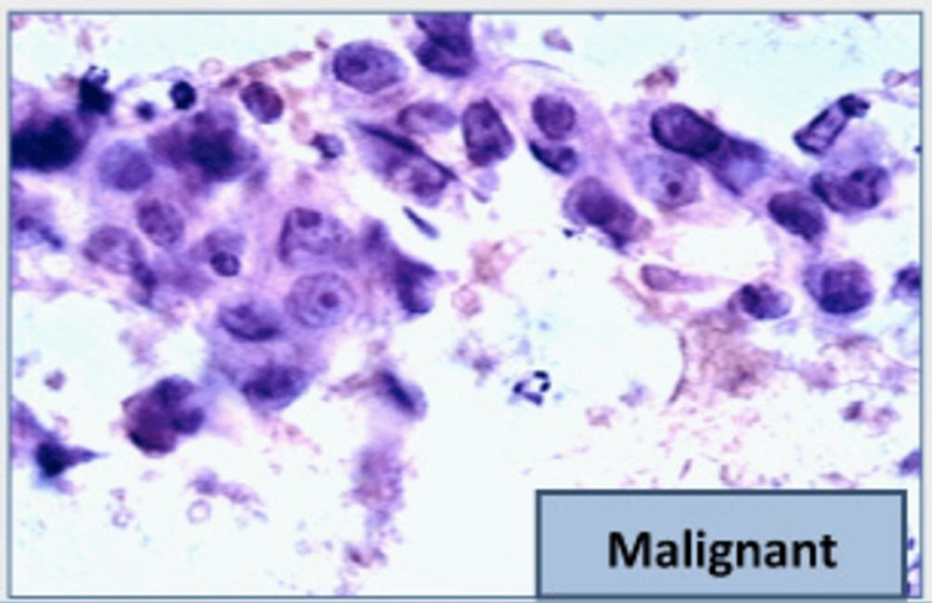
The Google Science Fair
Brittany Wenger, a 17-year-old high school student in 2012
Won by building a breast cancer classifier with 99% accuracy
(Demo)

Slide 14
Rows

Slide 15
Rows of Tables
Each row contains all the data for one individual
t.row(i) evaluates to ith row of table t
t.row(i).item(j)is the value of column j in row i
If all values are numbers, then np.array(t.row(i))
evaluates to an array of all the numbers in the row.
To consider each row individually, use
for row in t.rows:
… row.item(j) …
t.exclude(i)evaluates to the table t without its ith row

Slide 16
Distance

Slide 17
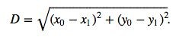
Pythagoras’ Formula
(x₀, y₀)
y₀ - y₁
(x₁, y₁)
x₀ - x₁

Slide 18
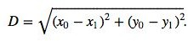
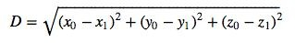
Distance Between Two Points
Two attributes x and y:
Three attributes x, y, and z:
(Demo)
and so on ...

Slide 19
Nearest Neighbors

Slide 20
Finding the k Nearest Neighbors
To find the k nearest neighbors of an example:
Find the distance between the example and each example in the training set
Augment the training data table with a column containing all the distances
Sort the augmented table in increasing order of the distances
Take the top k rows of the sorted table

Slide 21
The Classifier
To classify a point:
Find its k nearest neighbors
Take a majority vote of the k nearest neighbors to see which of the two classes appears more often
Assign the point the class that wins the majority vote
(Demo)

Slide 22
Evaluation

Slide 23
Accuracy of a Classifier
The accuracy of a classifier on a labeled data set is the proportion of examples that are labeled correctly.
Need to compare classifier predictions to true labels.
If the labeled data set is sampled at random from a
population, then we can infer accuracy on that population.
Sample | Labels
Training
Set
Test Set
(Demo)

Slide 24
Before Classifying

Slide 25
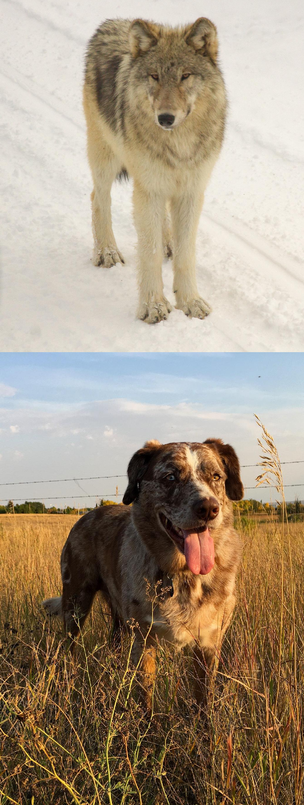



Dog or Wolf?

Slide 26
Start with a Representative Sample
Both the training and test sets must accurately represent the population on which you use your classifier
Overfitting happens when a classifier does very well on the training set, but can’t do as well on the test set

Slide 27
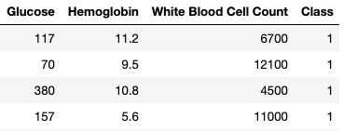
Standardize if Necessary
Chronic Kidney Disease data set
If the attributes are on very different numerical scales, distance can be affected
In such a situation, it is a good idea to convert all the
variables to standard units
(Demo)

Slide 28
Decisions

Slide 29
Decisions Under Uncertainty
Interpretation by Physicians of Clinical Laboratory Results (1978)
"We asked 20 house officers, 20 fourth-year medical students and 20 attending physicians, selected in 67 consecutive hallway encounters at four Harvard Medical School teaching hospitals, the following question:
"If a test to detect a disease whose prevalence is 1/1000 has a false positive rate of 5%, what is the chance that a person found to have a positive result actually has the disease, assuming that you know nothing about the person's symptoms or signs?"

Slide 30
Decisions Under Uncertainty
Interpretation by Physicians of Clinical Laboratory Results (1978)
"Eleven of 60 participants, or 18%, gave the correct answer. These participants included 4 of 20 fourth-year students, 3 of 20 residents in internal medicine and 4 of 20 attending physicians. The most common answer, given by 27, was that [the chance that a person found to have a positive result actually has the disease] was 95%.

Slide 31
Conditional Probability

Slide 32
Scenario 1
Scenario:
Class consists of second years (60%) and third years (40%)
50% of the second years have declared their major
80% of the third years have declared their major
I pick one student at random.
Which is more likely: Second year or Third year?
Second year, because they are 60% of the class

Slide 33
Scenario 2
Slightly different scenario:
Class consists of second years (60%) and third years (40%)
50% of the second years have declared their major
80% of the third years have declared their major
I pick one student at random... That student has declared a major!
(Demo)
Which is more likely: Second Year or Third Year?

Slide 34
Bayes' Rule

Slide 35
Purpose of Bayes’ Rule
Update your prediction based on new information
In a multi-stage experiment, find the chance of an event at an earlier stage, given the result of a later stage

Slide 36
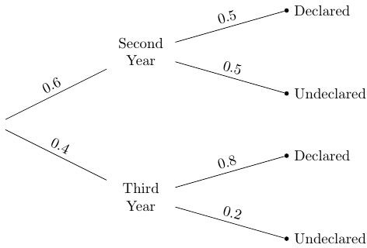
Diagram and Terminology
Prior probability
Likelihood
Likelihood
Prior probability

Slide 37
Data & Calculation
Posterior probability:
P(Third Year | Declared)
0.4 x 0.8
=
(0.6 x 0.5) + (0.4 x 0.8)
= 0.5161…
Pick a student at random.

Slide 38
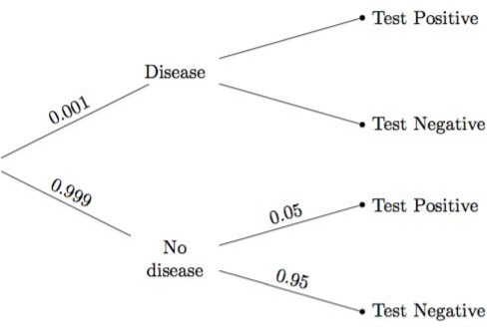
Example: Doctors & Clinical Tests
Problem did not give the
true positive rate.
That’s the chance the test says “positive” if the person has the disease.
It was assumed to be 100%.
?
?

Slide 39
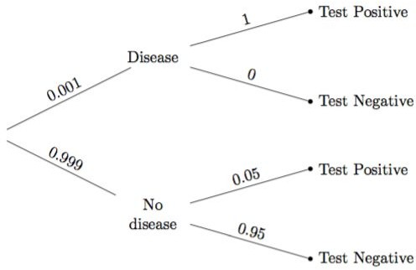
Data and Calculation
P(Disease | Test +)
=
0.001 * 1
(0.001 * 1) + (0.999 * 0.05)
= 0.0196270…
(Demo)

Slide 40
Subjective Probabilities

Slide 41
Subjective Probabilities
A probability of an outcome is…
The frequency with which it will occur in repeated trials, or
The subjective degree of belief that it will (or has) occurred
Why use subjective priors?
In order to quantify a belief that is relevant to a decision
If the subject of your prediction was not selected randomly from the population

Slide 42
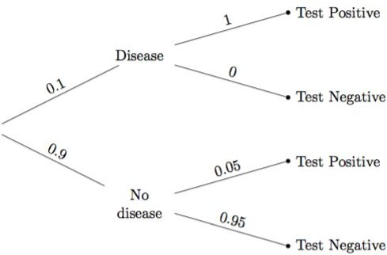
A Subjective Opinion
prior probability that the person has the disease
(Demo)

Slide 43
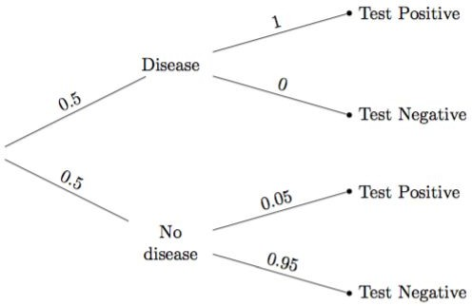
A Different Subjective Opinion
prior probability that the person has the disease
(Demo)

